Slide 1
PROJECT TITLE: PREDICTIVE ANALYSIS OF CLIMATE CHANGE (PACC)
JUNE-2022
RESEARCH REPORT
Talha Siddiqui 1812267
Abdul Wasay 1812254
Syed Arhum-Ul-Hassan 1812281

Slide 2
CONTENTS
Abstract
Introduction
Literature Review
Problem statement
Solution statement-Techniques
Objectives
Research Questions
Methodology
Tools and Technology Considered
Result
Future Work
Conclusion
References

Slide 3
ABSTRACT
Climate had been changing negatively throughout the world due to excessive Global warming and weakening of ozone layer and Pakistan situated in Southern Asia is facing its effects immensely in form of extreme temperatures, less rainfall and poorer air quality.
The study of climate change has been made difficult due to the lack of relevant data available, the accuracy of the existing methods proving to be ineffective.
Introduction of machine learning algorithms to interpret the data and predicting the change in future will provide the researchers with the information required either to prevent it from happening or to create adaptation policies for it.

Slide 4
ABSTRACT (continued)
We will be using various models defined in our research onto our data scrapped from different sources and illustrate its usefulness with quantitative analysis.
Our interpretations will be providing a predictive analysis for the researchers in analyzing the trends and patterns from the historical patterns to the predicted patterns and take precautionary measures in how to avoid any disastrous situation.
We culminate the paper by reflecting on the merits and pitfalls of using ML algorithms, which algorithm proves to be the most efficient and provides with the best accuracy for the resultant values.

Slide 5
INTRODUCTION
Climate is drastically changing throughout out the world due to global warming which shows a change in weather pattern.
From shifting weather patterns that threaten food production, to rising sea levels that increase the risk of catastrophic flooding, the impacts of climate change are global in scope and unprecedented in scale.
Using these predictions to accurately predict global climate change and its effects on the environment and terrain.

Slide 6
LITERATURE REVIEW
TITLE | PUBLICATION YEAR | PROBLEM STATEMENT | METHODOLOGY
Application of artificial neural networks in global climate change and ecological research. | 2010 | ANNs accuracy and efficiency with respect to global climatic datasets. | Paper also states that ANN’s remain a better choice than many traditional methods when dealing with nonlinear problems, and possesses great potential for the study of global climate change and ecological issues
An evaluation of CNN and ANN in prediction weather forecasting | 2021 | Accuracy of weather forecasting had been inefficient due to poor efficiency of algorithms. | Two NN system designs have been selected to be utilized as weather prediction models for vitality utilization.

Slide 7
LITERATURE REVIEW
TITLE | PUBLICATION YEAR | PROBLEM STATEMENT | METHODOLOGY
Time Series Analysis of Climatic Variables in Peninsular Spain. | 2021 | Prediction of weather depending on time series and patterns previously defined. | The paper represents ARIMA models that were used to reflect the changes in weather trends over the period 1940-2013.
Climate Changes Prediction Using Simple Linear Regression. | 2019 | The rise in global temperatures, frequent natural disasters and rising sea levels, have made the problem of understanding and predicting these global climate phenomena | The paper represents easy linear regression approach for the early prediction of rainfall to help farmers for taking suitable decisions on crop yielding.

Slide 8
LITERATURE REVIEW
TITLE | PUBLICATION YEAR | PROBLEM STATEMENT | METHODOLOGY
Weather Prediction System Using KNN Classification Algorithm | 2022 | Prediction of weather depending on time series and patterns previously defined. | The paper represents the usage KNN Models on previous dataset for weather prediction.
Prediction of Sea Surface Temperature using Long Short-Term Memory. | 2017 | Prediction of Sea Surface Temperature. | The paper represents a proposed architecture of LSTM and fully-connected dense layer to fulfil the problem statement.

Slide 9
PROBLEM STATEMENT
During the next few decades and beyond, global warming is expected to cause further destruction. As we know that climate change is causing many other aspects of Earth to change.
From shifting weather patterns that threaten food production, to rising sea levels that increase the risk of catastrophic flooding, the impacts of climate change are global in scope and unprecedented in scale
Without drastic action today, adapting to these impacts in the future will be more difficult and costly.
Using models, we can project how these aspects of Earth are likely to change in the future as the climate continues to vary.

Slide 10
SOLUTION STATEMENT
We proposed a system which provide the overall analysis in change of climate over the years and the prediction for the future.
We believe that mitigating climate change is not only important for global peace and security, but key to fulfilling our moral imperative to protect those communities most at risk.
This system would be used to predict the climate change over the years and its effects on the environment of Pakistan.

Slide 11
SOLUTION STATEMENT-Techniques
Using different datasets to be processed by multiple models
Will use different algorithms on variety of datasets to achieve the best accuracy for a particular model.
Differentiating between different algorithms and selecting those with the highest efficiency, best accuracy, lowest root mean square error and residual sum of squares.

Slide 12
OBJECTIVES
The objective of this project is to asses climate change factors and further predict how these factors will change in the future effecting the climate

Slide 13
RESEARCH QUESTIONS
Where is the climate of Pakistan headed in the near future and how will it affect the society?
What will be the effects of global warming for climate of Pakistan and when should we prepare for the disasters that are inevitable?

Slide 14
METHODOLOGY
Process different datasets.
Train models for each factor effecting climate change.
Our systems would be tested for efficiency & accuracy in-order to find prediction pattern for the near future.
Once we have the predictive analysis of those factors, the predicted data will be used to integrate all the factors into one main predictive analysis model that will provide the overall analysis in change of climate over the years and the prediction for the future.

Slide 15
TOOLS & TECHNOLOGY CONSIDERED
Using Different software's:
MS Word for documentation
MS Excel for Datasets
Spyder for Python Programming
Programming tools and languages
Python
Libraries of python such as TensorFlow, Pandas, NumPy, Matplotlib, Keras Sckeit-learn and as per our requirement.

Slide 16
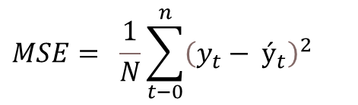
RESULTS
Long Short-term Memory (LSTM)
Test Case ID | Test Case Name | Test Case Summary | MSE | MAE
1. | Max Temp Forecasting | Forecasting maximum temperature using LSTM (RNN) | 0.1225275 | 0.0269616
We compared the performance and check the
Model validation using error calculation.
Equation:
$$MSE= \frac{1}{N}\sum_{t−0}^{n}{{\left(y_{t}− ý_{t}\right)}^{2}}$$
This table explains the test case for Maximum
temperature trained on 10 epochs using LSTM
Model.
Mean Square Error (MSE)

Slide 17
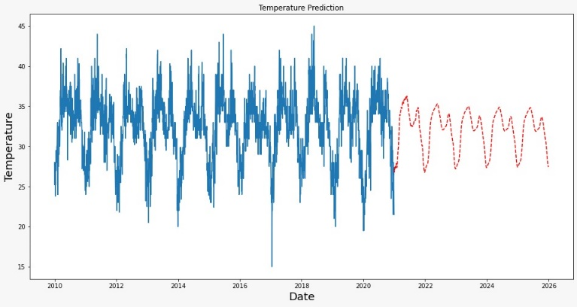
RESULTS
Long Short-term Memory (LSTM)
This graph shows the 5 years of predicted maximum temperature in the city of Karachi.

Slide 18
RESULTS
Long Short-term Memory (LSTM)
Serial # | Actual | Predicted
0 | 30.0 | 29.332
1 | 32.0 | 31.221
2 | 33.0 | 33.846
3 | 34.5 | 34.023
4 | 32.5 | 33.889
This table shows the head of the data frame that shows the actual and predicted values.

Slide 19
FUTURE WORK
The results of the proposed work are efficient and encouraging for us to explore the domain further by including more factors and extending our scope with disaster prediction as well in relate to the predicted values.
Based on our result we can conclude that an accurate prediction model will help the country in various sectors especially in agriculture to cultivate their farms according to the weather predicted and also in disaster management to take precautionary measures long before the time arrives.
In future, we would like to develop this model further based on different climatic parameters as well as disaster prediction.

Slide 20
CONCLUSION
Data mining techniques are an efficient method of analyzing and compiling data from various sources. These techniques are helpful for the pre-processing of the data and using ML algorithms for prediction is a better solution then those inefficient ways country’s meteorological department opt for.
This paper concludes that using Data mining techniques for data gathering and pre-processing and using LSTM along with Recurrent Neural network for climate change prediction gives a close to accurate result and can be considered as an alternative for previous traditional methods. Comparison shown in this paper between actual and predicted values showcases that the use of these algorithms is of one of the best suited techniques for this application. For this reason, the main dependency in predicting these factors is the unbiased availability of the data.

Slide 21
REFERENCES
Khan, Z. &. (2014). Hourly Based Climate Prediction Using Data Mining Techniques by Comprising Entity Demean Algorithm.
Liu Z L, P. C. (2010). Application of artificial neural networks in global climate change and ecological research. An overview. . ChineseSci Bull, 2010, 55: 3853.
Mulomba Mukadi, P. G.-G. (2021). Time Series Analysis of Climatic Variables in Peninsular Spain. Trends and Forecasting Models for Data between 20th and 21st Centuries.
S. Kareem, Z. J. (2021). An evaluation of CNN and ANN in prediction weather forecasting: A review. Sustainable Engineering and Innovation, vol. 3, no. 2, pp. 148-159.
Sreehari, E. &. (2019). Climate Changes Prediction Using Simple Linear Regression. Journal of Computational and Theoretical Nanoscience.
Yousif. (2013). Weather Prediction System Using KNN Classification Algorithm.
Muhuri, P. &. (2020). Using a Long Short-Term Memory Recurrent Neural Network (LSTM-RNN) to Classify Network Attacks.
Jitendra Kumar, R. G. (2018). Long Short Term Memory Recurrent Neural Network (LSTM-RNN) Based Workload Forecasting Model For Cloud Datacenters.

